Slide 1


Introduction to Machine Learning Workshop DRAFT!
Filipe Barata, Konstantin Hopf
Bamberg | 20. September 2017

Slide 2
Agenda
Part A (13:15 – 14:45)
Intro/basics/general input for machine learning (30 min, Filipe)
Walk-through R code (30 min, Konstantin)
Hands on: load data, feature extraction, classification (30 min)
Part B (15:15 – 16:45)
Short intro: feature extraction from trading data (5-10 min, Filipe)
Hands on: feature development (20 min)
Technical input: classification algorithms and parameter (30 min, Konstantin)
Hands on: tune model (20 min)
Wrap-up: comparison of model performances, feedback (10 min)

Slide 3
Classification algorithms - Overview
Decision trees
k Nearest Neighbors
Learns a decision tree from the data
Important parameters: depends on the tree learning algorithm
Infers the class membership from its k nearest neighbors
Important parameters: k, distance metric
Random Forest
Support Vector Machine
Evaluates a number of uncorrelated decision trees for their suitability
Important parameters: number of trees, parameters for decision tree generation
Searches for a maximum margin around the decision boundary (even in higher-dimensional space)
Important parameters: C (cost of misclassification), kernel function with their parameters, …

Slide 4
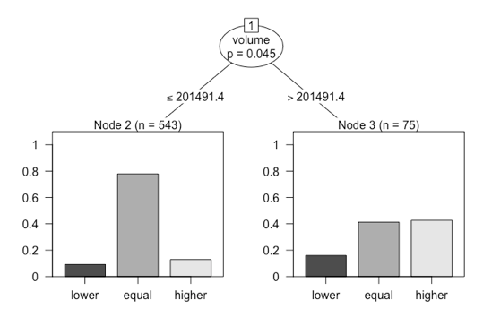
Decision trees
A typical decision tree learner generates one decision tree from the data
Multiple algorithms exist
Typical approach:
Sort features by the association to the dependent variable
For each feature that was not processed: implement a binary split to divide the data into the classes

Slide 5
R syntax for decision tree algorithm (package “party”)
model_DT <- ctree( formula, data,
controls=ctree_control(testtype=“Univariate”, ...),
... )
This implementation calculates the association between features and the dependent variable using statistical tests
Example parameters passed with the function ctree_control:
testtype: defines the statistical test used
mincriterion: the 1-p-value level as decision rule
maxdepth: maximum depth of the tree (standard: unlimited)
minsplit, minbucket, mtry: further specify tree generation

Slide 6
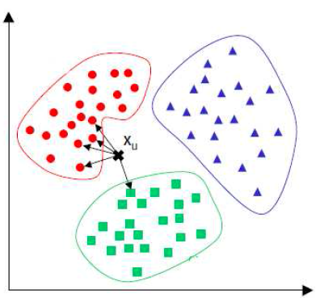
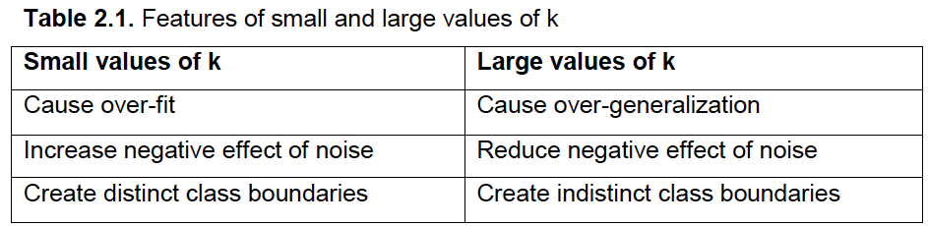
k Nearest Neighbor (kNN)
Learning rule: assign the most frequent class of the nearest k examples
kNN is a “lazy-learner”, since the learning is postponed to the prediction phase. There is no explicit training of kNN.
There is no general rule for the “best k”, it depends on the problem and the data
The distance metric can be varied (typical: Euclidean distance)
Source: P. Rai

Slide 7
R syntax for kNN algorithm (package “class”)
prediction_kNN <- knn( train, test, cl,
k = 1, l = 0, prob = FALSE, use.all = TRUE)
In this implementation, only the Euclidean distance can be used
Parameters:
train, test: feature sets for training and test cases
cl: the true class labels for training cases
l: minimum vote for definite decision (must be less than k-1)
prob: returns probabilities as relative frequencies of the class in k nearest neighbors
Other implementations are provided by packages “caret” or “FNN”

Slide 8
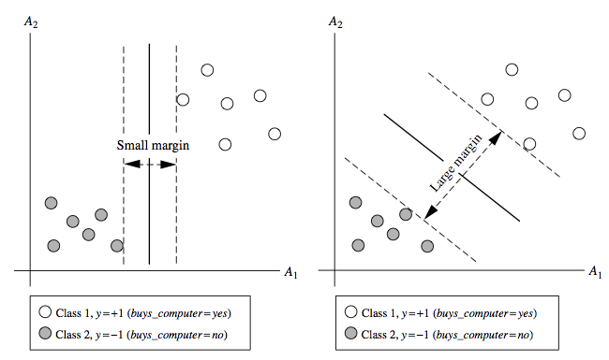
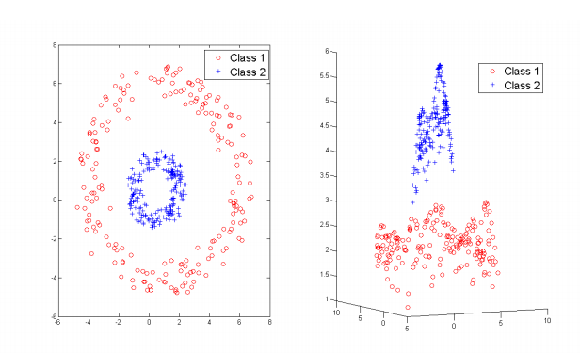
Support Vector Machine (SVM)
The aim of SVM is to find a hyperplane (line in a two dimensional case) that “best” separates the two classes from each other (optimization problem)
The hyperplane is defined with support vectors
When the data is no linearly separable, a kernel function is used to map the data into a higher dimensional space, where the data can be linearly separated.
Linearly separable case
Not linearly separable case
Notes:
immer konvexes problem

Slide 9
R syntax for SVM (package “e1071”) and parameters
model_SVM <- svm( formula, data,
cost,
kernel, degree, coef0, gamma,
scale = TRUE, ...)
Multiple parameters are available to “tune” the SVM:
cost: cost of misclassification → influences the size of the margin around the hyperplane
kernel: the kernel function (either “linear”, “polynomial”, “radial basis” a.k.a. Gaussian, “sigmoid”)
degree, gamma, coef0: parameters to the kernels
Meaningful parameter values for grid-search:
Parameter | Possible range | Meaningful values
kernel | linear, radial basis, polynomial, sigmoid
eps | Decimal | 0.1
cost | Decimal | 2E^2(-5, …, 10)
deg | Decimal | 2, 3, 4, 5
coef | Decimal | 0, 1, 5, 10, 100

Slide 10
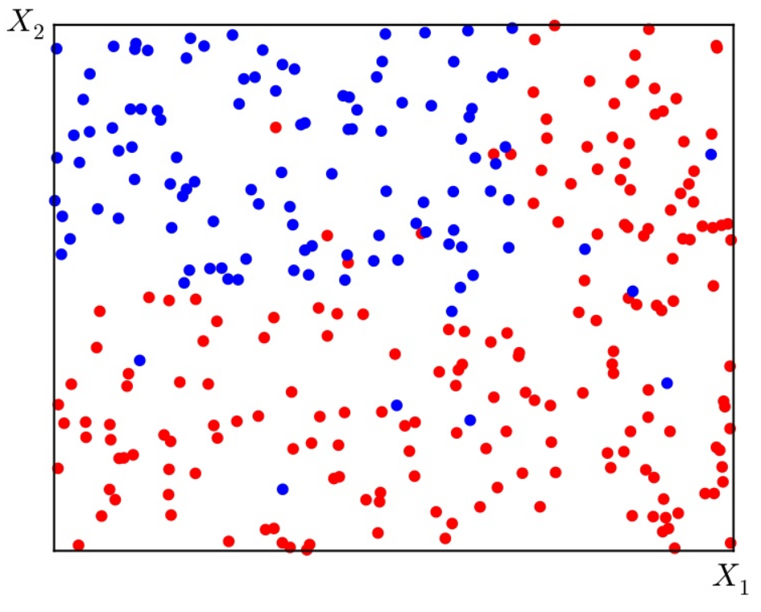
Random Forest
Divide and conquer approach:
Is an ensemble learner; that means multiple weak learners are combined to one strong learner
Approach:
The random forest algorithm generates multiple low correlated decision trees (by subsampling the training set) that are evaluated with performance measures → weights for each tree are calculated
For classification, the prediction of each decision tree is weighted for the final prediction of the “forest”
Notes:
nicht immer lösbares Problem

Slide 11
R syntax (package “randomForest”) and parameters
model_RF <- randomForest( formula, data,
ntree,
mtry, ...)
Additionally to parameters of the used decision tree algorithm, the following parameters can be used to “tune” the Random Forest:
ntree: number of trees to grow (not too small, initially 500)
mtry: number of variables randomly sampled as candidates at each split
nodesize: Minimum size of terminal nodes
samsize, strata: controls the subsample generation

Slide 12
Do we Need Hundreds of Classifiers to Solve Real World Classification Problems?
Abstract: “We evaluate 179 classifiers arising from 17 families […] including all the relevant classifiers available today. We use 121 data sets, […] in order to achieve significant conclusions about the classifier behavior, not dependent on the data set collection. The classifiers most likely to be the bests are the random forest (RF) versions, the best of which (implemented in R and accessed via caret) achieves 94.1% of the maximum accuracy overcoming 90% in the 84.3% of the data sets. However, the difference is not statistically significant with the second best, the SVM with Gaussian kernel implemented in C using LibSVM, which achieves 92.3% of the maximum accuracy. […] The random forest is clearly the best family of classifiers (3 out of 5 bests classifiers are RF), followed by SVM (4 classifiers in the top-10), neural networks and boosting ensembles (5 and 3 members in the top-20, respectively).”
Fernández-Delgado, M., Cernadas, E., Barro, S., & Amorim, D. (2014). Do we need hundreds of classifiers to solve real world classification problems. J. Mach. Learn. Res, 15(1), 3133-3181.

Slide 13
Other machine learning algorithms
Statistical approaches:
Discriminant analysis
Bayesian learners
Partial least squares / principal component regression
Multivariate adaptive regression splines
Artificial neural networks
Ensemble learners (Bagging, Boosting)
Hidden Markov Models
Inductive logic programming
Genetic algorithms
Reinforcement learning
Unsupervised learning
…

Slide 14
Beyond classifier tuning – some advices:
Please keep in mind: data matters! (“bullshit in – bullshit out”)
Is that what you predict really that what you are interested in? ➔ Think about the definition of the dependent variable!
Are you interested in the best x% → use the classifier probabilities
Are you interested in a minority class? → use class weights or consider over/undersampling
Scale all features to the same dimension (some implementations provide parameters to do that)
Consider feature selection when you have > 20 features to overcome the “curse of dimensionality”

Slide 15
Logistic regression with feature selection achieved Accuracy results that are nearly as high as those from SVM or Random Forest without feature selection
Evaluation method
Benchmark (no feature selection)
Hopf, Weigert (2017)
Change in Accuracy (compared to no feature selection)
Change in Accuracy (compared to no feature selection)
We benchmarked 43 feature selection methods on 22 classification problems from energy retail with ca. 250 features (smart meter household classification)

Slide 16
Backup

Slide 17
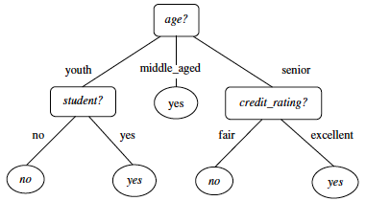
Decision Tree
Example: A decision tree for the prediction whether a company customer is likely to purchase a computer. Each internal (non-leaf) node represents a test on an attribute. Each leaf node represents a class (either buys computer = yes or buys computer = no).
„How are decision trees used for classification?”
Given an object X for which the associated class label is unknown, the attribute values of the tuple are tested against the decision tree. A path is traced from the root to a leaf node, which holds the class prediction for that tuple.
Decision trees can easily be converted to classification rules (which is a great advantage – it makes the results traceable).

Slide 18
Decision Tree: Attribute Selection
An attribute selection measure is a heuristic for selecting the splitting criterion that “best” separates a given data partition D of class-labeled training tuples into individual classes.
Popular attribute selection measures: information gain, gain ratio , and Gini index.
Notation: Let the data partition D be a training set of class-labeled tuples. Suppose the class label attribute has m distinct values defining m distinct classes Ci (for i = 1, . . . , m ). Let C_{i,D} be the set of tuples of class Ci in D . Let |D| and |C_{i,D}| denote the number of tuples in D and C_{i,D}, respectively.
Information gain uses Shannon entropy which minimizes the information needed to classify the tuple in the resulting partitions and reflects the least randomness or “impurity” in these partitions.
Notes:
|D| : Cardinality of the data partition

Slide 19
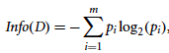
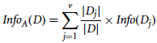
Informatin gain
The expected information needed to classify a tuple in D is given by the entropy:
where pi is the nonzero probability that an arbitrary tuple in D belongs to class Ci and is estimated by |C_{i,D}| /|D|.
Info( D) is the average amount of information needed to identify the class label of a tuple in D
Now, suppose we were to partition the tuples in D on some attribute A having v distinct values, {a1 , a2 , . . . , av}, as observed from the training data.
A can be used to split D into v partitions { D1, D2, . . . , Dv}, where Dj contains those tuples in D that have outcome aj of A.
How much more information would we need after the partitioning to arrive at an exact classification? The expected information required to classify a tuple from D based on the partitioning by A:
Information gain is the difference between the original information requirement and the new requirement:
← minimize
← maximize

Slide 20
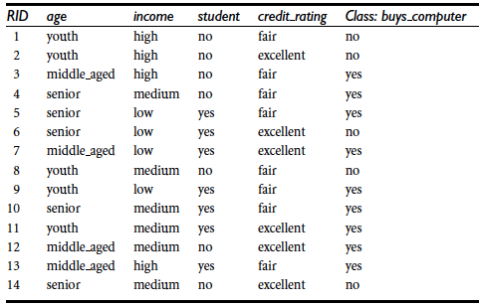
Exercise: Informatin gain
What attribute has the highest information gain? Make a split from the node

Slide 21
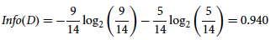
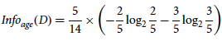
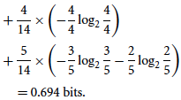
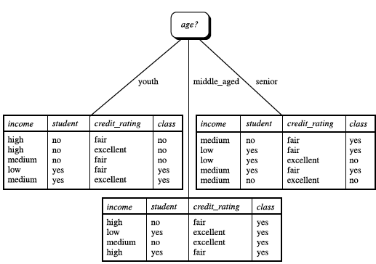
Exercise: Informatin gain (Solution)

Slide 22
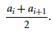
Informatin gain
Dealing with numeric variables:
Suppose that attribute A is continuous-valued (raw values on age).
We must determine the “best” split-point for A.
Sort the values of A in increasing order.
Typically, the midpoint between each pair of adjacent values is a possible split-point:
Given v values of A, v − 1 possible splits are evaluated.
For each possible split-point for A, evaluate Info_{A}(D)
Choose the best split (with minimal Info_{A}(D)).

Slide 23
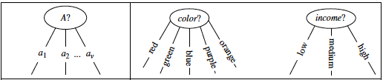
Decision Tree: Splitting
The splitting criterion tells us which attribute to test at node N by determining the “best” way to separate or partition the tuples in D into individual classes (step 6 on the previous slide).
The splitting criterion is determined so that, ideally, the resulting partitions at each branch are as “pure” as possible. A partition is pure if all the tuples in it belong to the same class.
Let A be the splitting attribute. A has v distinct values, {a1 , a2 , . . . , av} , based on the training data.
Case 1: A is discrete-valued. The outcomes of the test at node N correspond directly to the known values of A . A branch is created for each known value aj of A and labeled with that value.

Slide 24
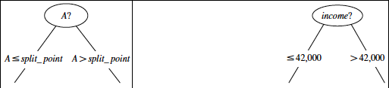
Decision Tree: Attribute Selection and Splitting
Case 2: A is continuous-valued. The test at node N has two possible outcomes corresponding to the conditions A <= split point and A >= split point, respectively, where split point is returned by the Attribute selection method.
In practice, the split-point is often taken as the midpoint of two known adjacent values of A and therefore may not actually be a preexisting value of A from the training data.

Slide 25
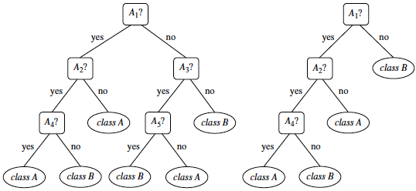
Tree pruning
Is needed to avoid data overfitting
Remove not reliable branches, make the tree less complex
Two approaches:
Prepruning, use some attribute selection measure to halt the tree construction early. The node becomes a leaf, e.g. using majority voting.
Postpruning, remove branches from the fully grown tree, based on the most common class in the sub-tree (“class B” on the figure).

Slide 26
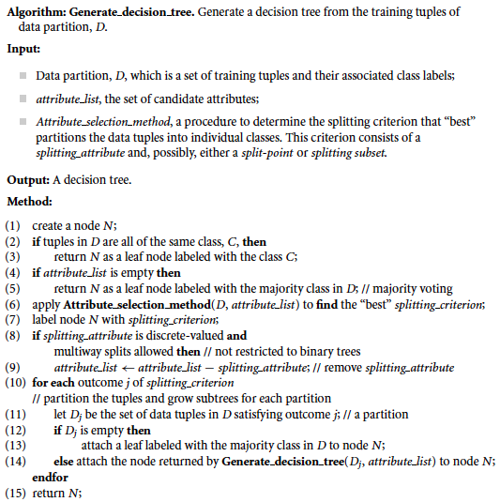
Decision Tree: Algorithm

